Slide 1
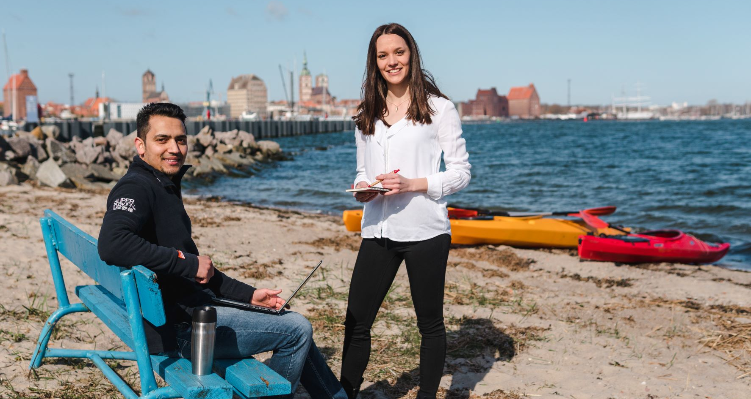
International ■ Strategic ■ Individual
Tourism Development Strategies Master Program

Slide 2
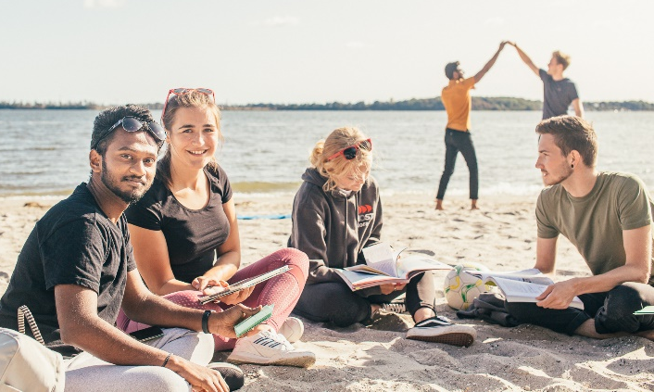
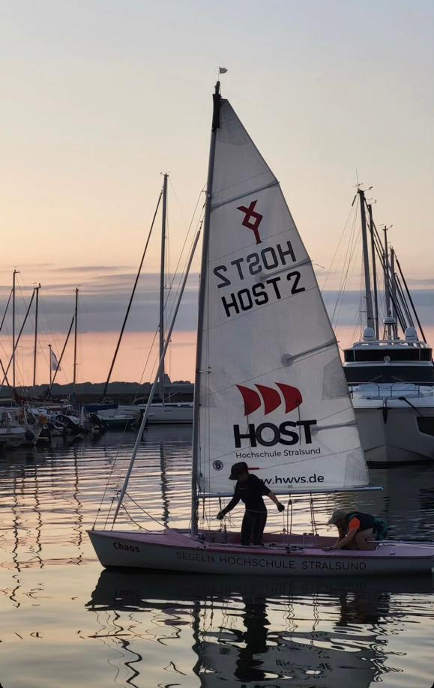
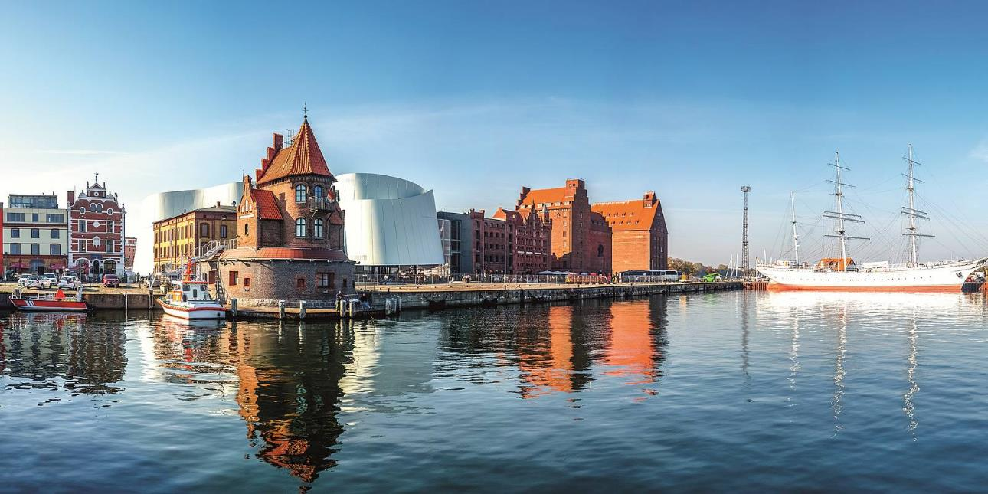
Welcome to Stralsund
2

Slide 3
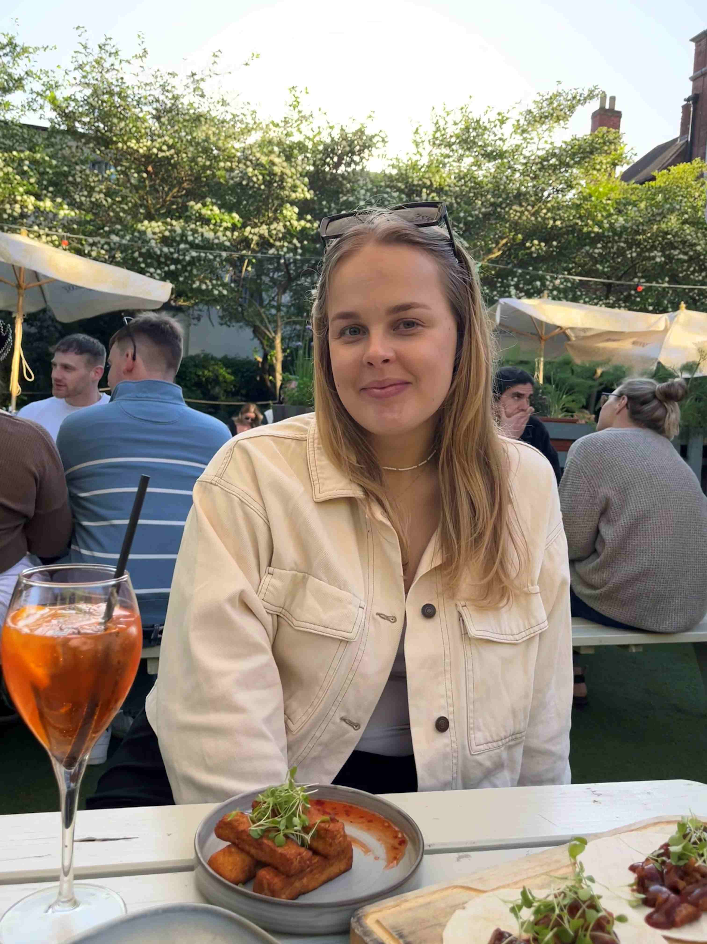
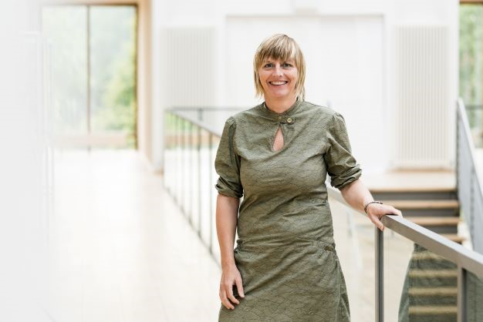
Who we are…
Nikita
TDS student, 2nd semester
Steffi Schnierer
Program Management
3

Slide 4
Agenda
Concept & Curriculum & Highlights
Campus & Student’s life
Employability
Application

Slide 5
At a Glance
Focus | Tourism + Management + Business Administration
Duration | 2, 3 or 4 semesters (depending on the BA degree)
Language 2-semester 3- and 4-semester | English 100% 90% | German 10%
Start | Winter term
Accreditation
Tuition | None
Program costs for e.g. international excursion 2-semester 3- and 4-semester | Program costs 1,970 EUR 2,170 EUR
5

Slide 6
Concept & Curriculum TDS
Entrance qualification
Process
Winter term
Summer term
Winter term
Summer term
Bachelor 180 ECTS
6 semester
Bachelor 210 ECTS
7 semester
Bachelor 240 ECTS
8 semester
4 semester
course
3 semester
course
2 semester
course
4/3/2 semester: start = winter term
core modules + excursion
core modules + excursion
core modules + excursion
Tourism + Management
Tourism + Management
Master Thesis
internship
21 weeks
Master Thesis
Final award TDS (M.A.)
Master Thesis
Final award TDS (M.A.)
Final award TDS (M.A.)

Slide 7
Philosophy
TDS Graduate Employability
Professional Expertise
Tourism
Business Administration
Management
Self-learning competence and personality
Development of an own value system
Learning strategies
Dealing with innovation & change
Methodological competence
Ability to think & act strategically
Self organization
Variety of teaching & exams
Social and multicultural competence
Appreciation of cultural diversity
Values based Management
English classes
7

Slide 8
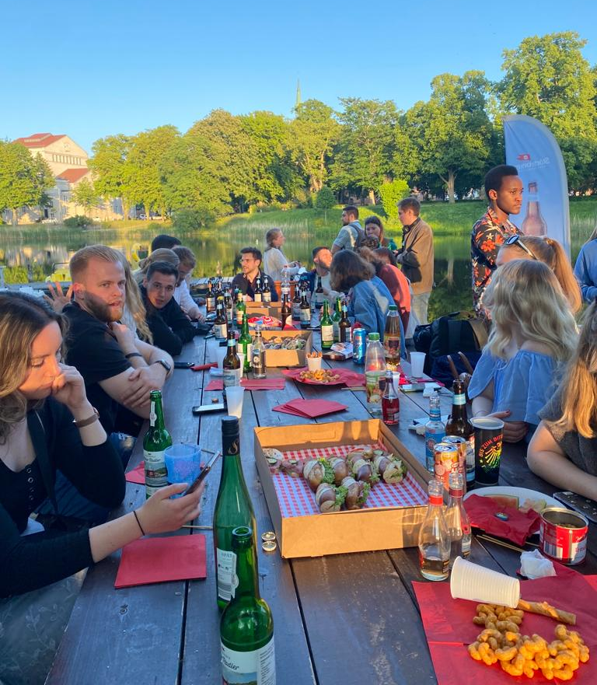
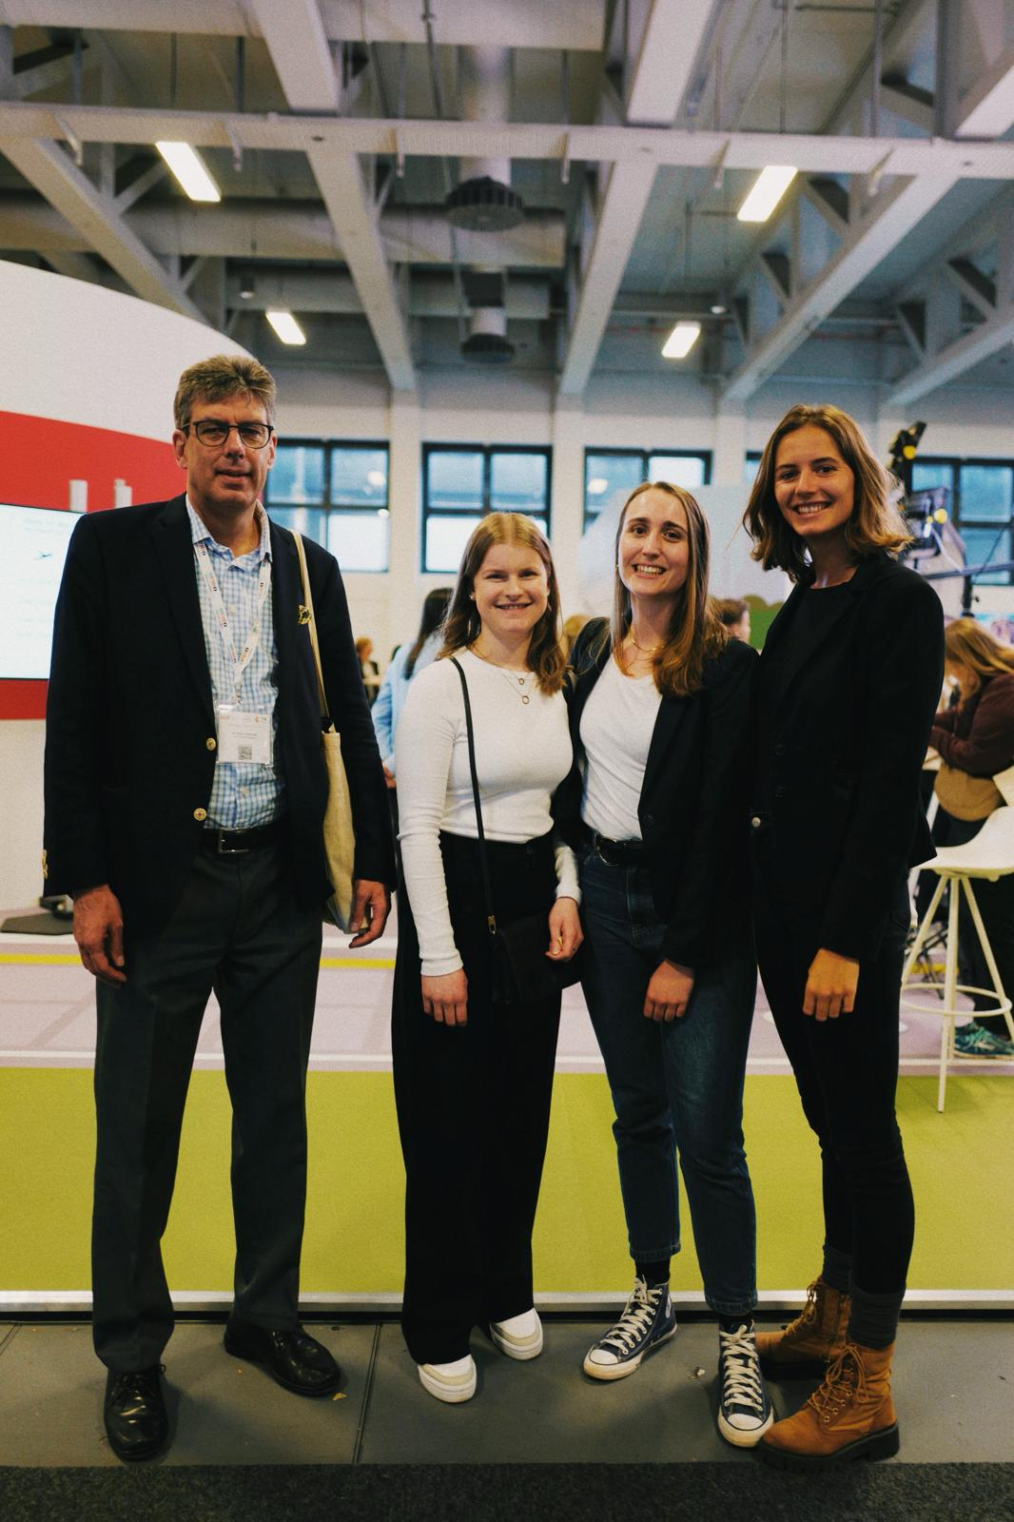
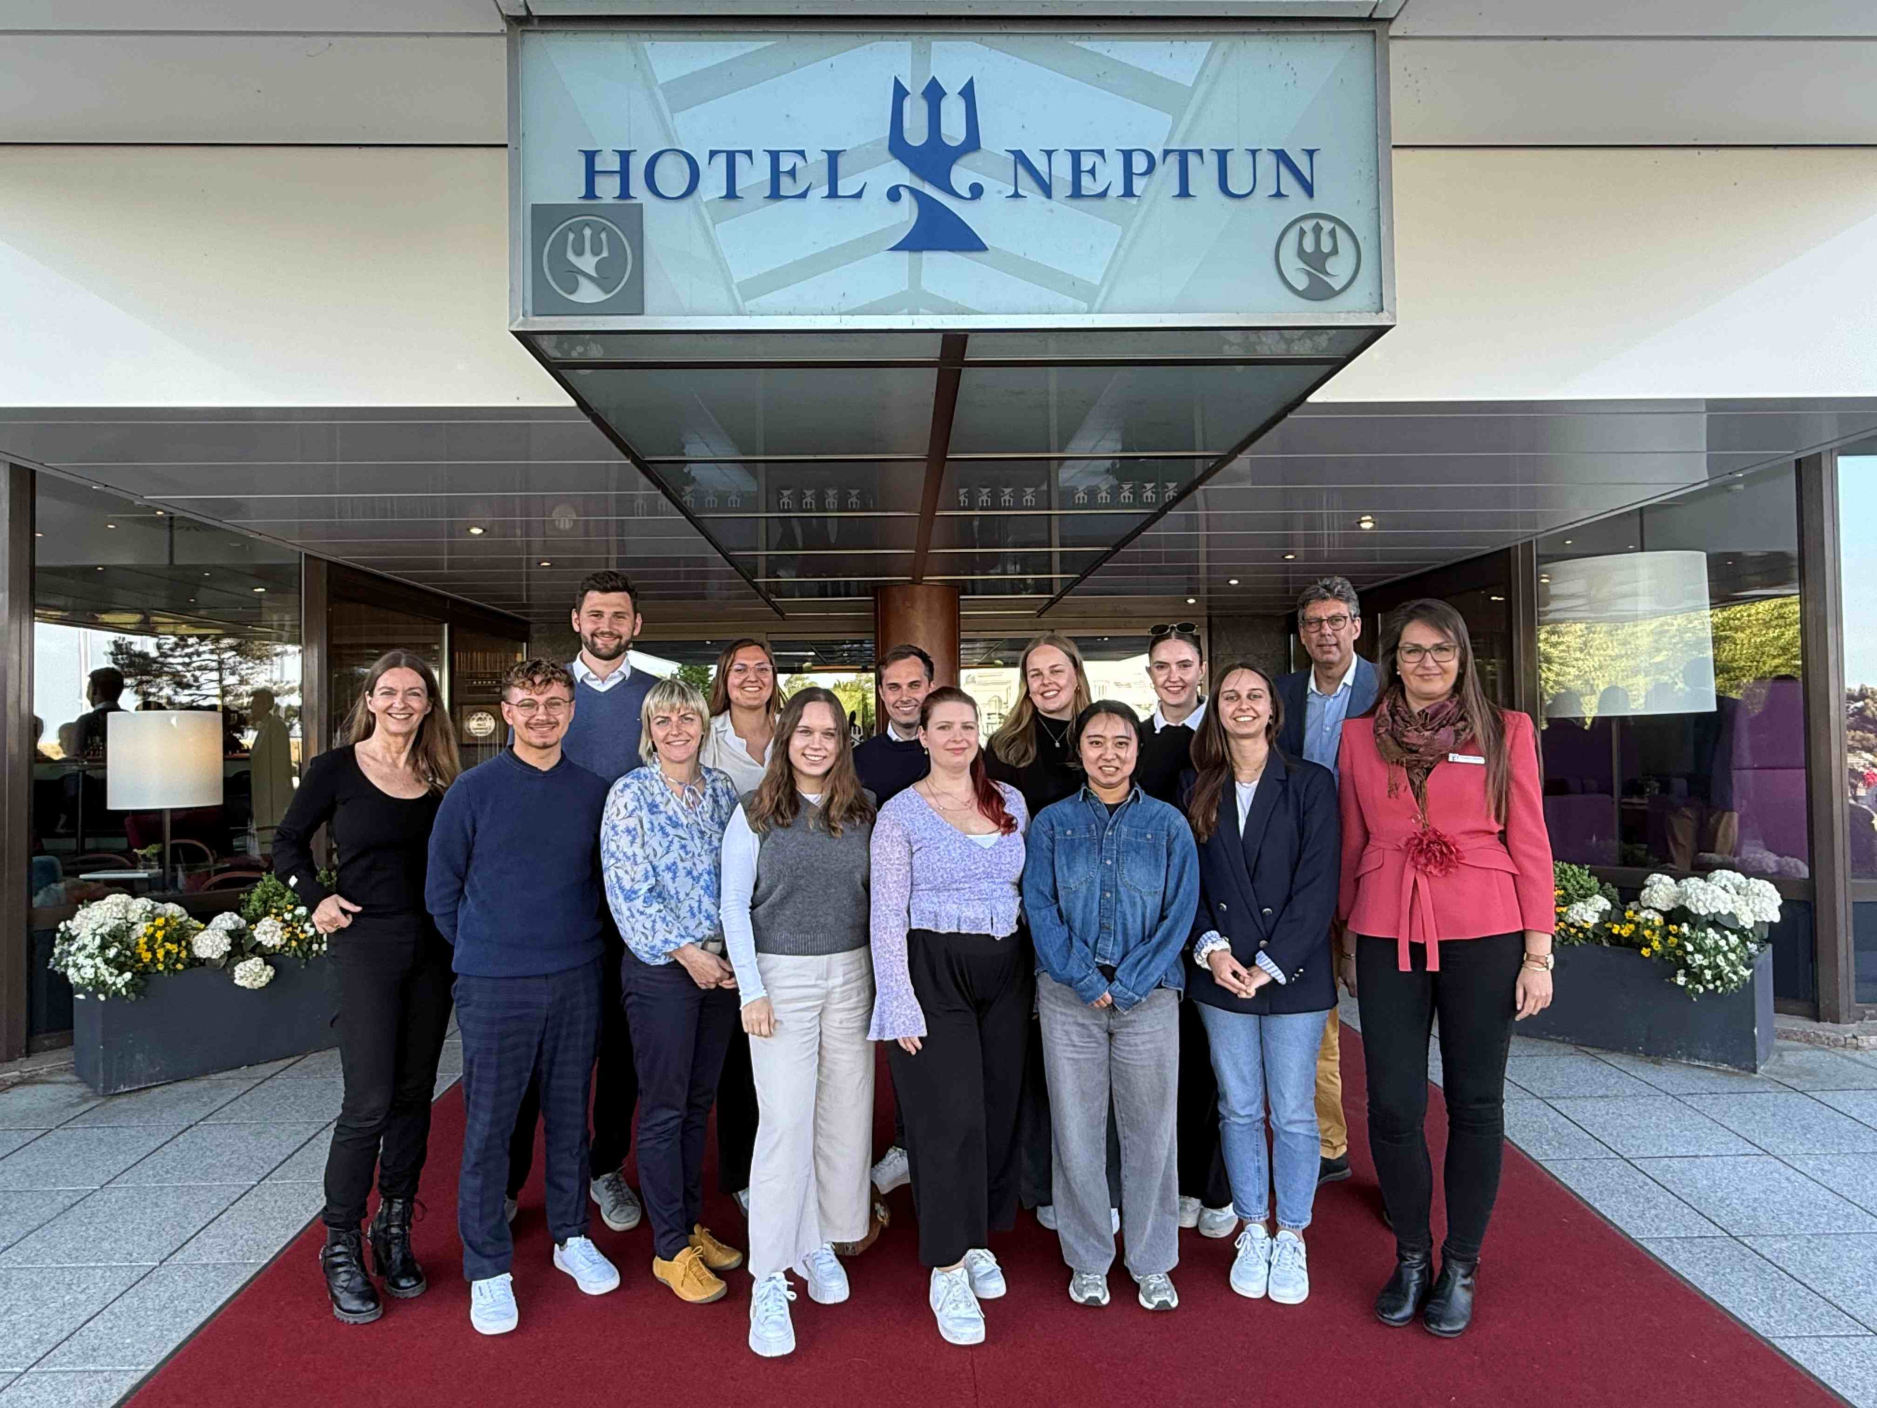
Theory and Practice Community, Conferences & Companies
v
Real-life case projects & internship
Meetings with companies & conferences
Real-life case projects & internship
Master Thesis with a company

Slide 9
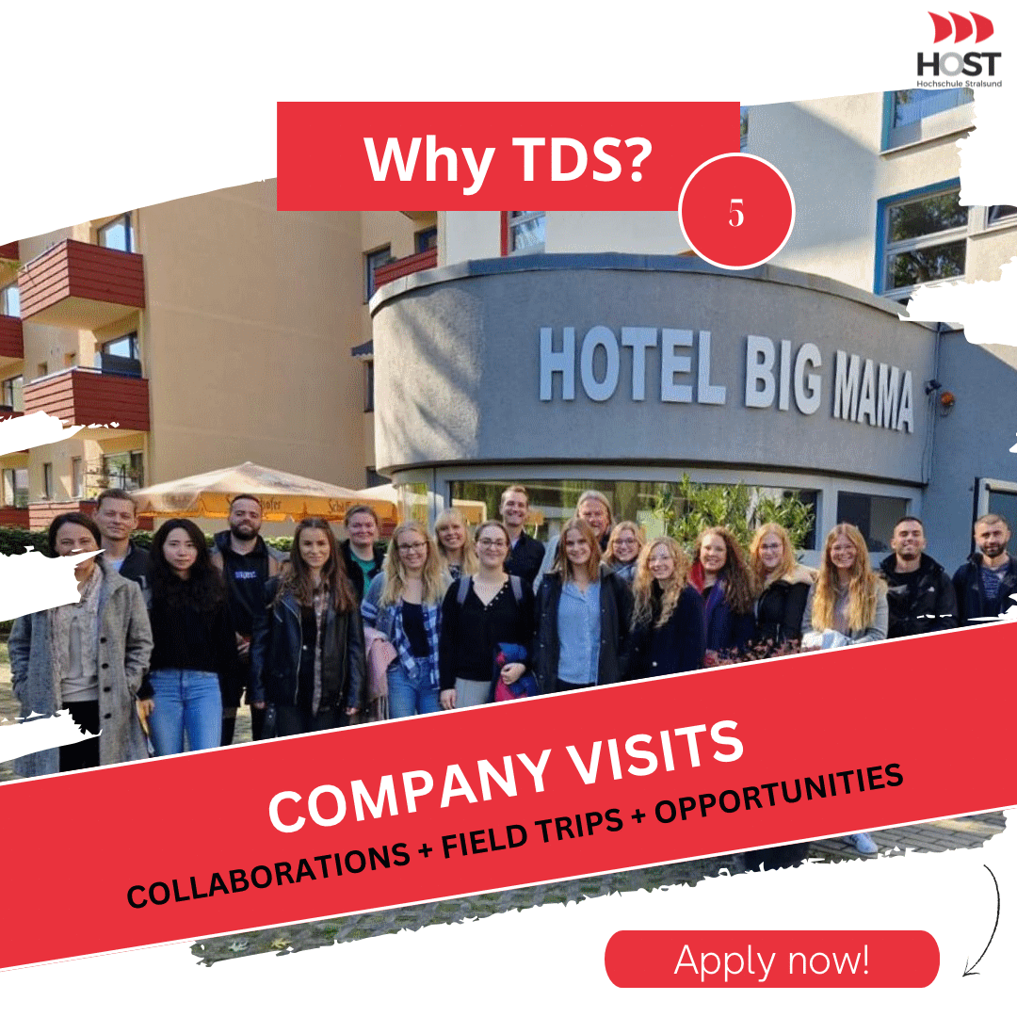
Concept
Integration of Theory and Practice
Examples of practice projects accompanying the semester:
THE BIG MAMA CASE. Differentiating hospitality via experiences
Leisure Theming and Tourism: Heide-Park Soltau
Shore Excursion Activities at AIDA Cruises
Business Development Plan for STAGE Entertainment

Slide 10
Concept & Curriculum
Tourism | Development | Strategies | Tourism & Management and Business Administration |  | Master’s Thesis
Tourism in Practice | Individual & Organisational Development | Research & Case Project | Managing Tourism Markets |  | Master’s Thesis and Colloquium
Sustainability in Tourism | Strategic HRM | Global Business Development | Tourism and Digitalization |  | Scientific Training
Destination | Personal Skill Development | Political Economy of Tourism | Supply Chain Management in Tourism
Cultural Heritage Management in Tourism |  |  | Communication & Media Management
 |  |  | Managing Financial Performance
Legend: lectures 2 semester course

Slide 11
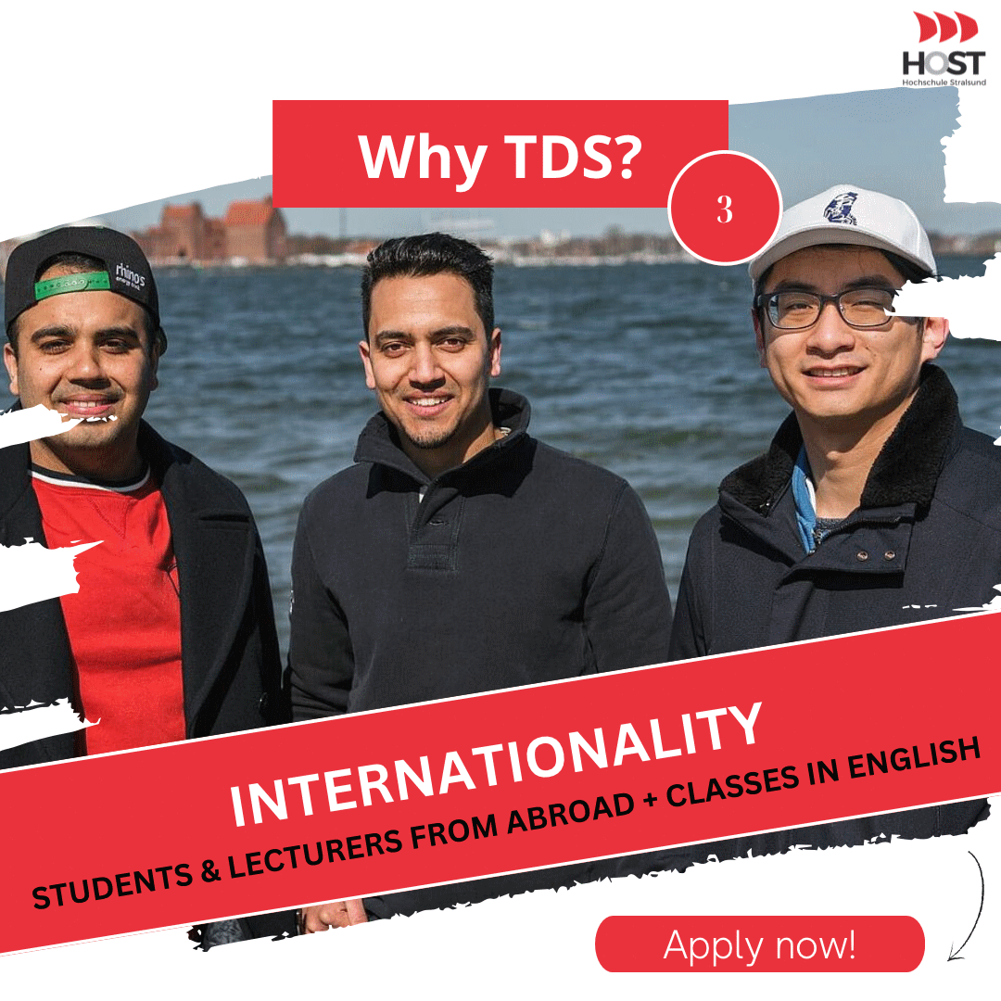
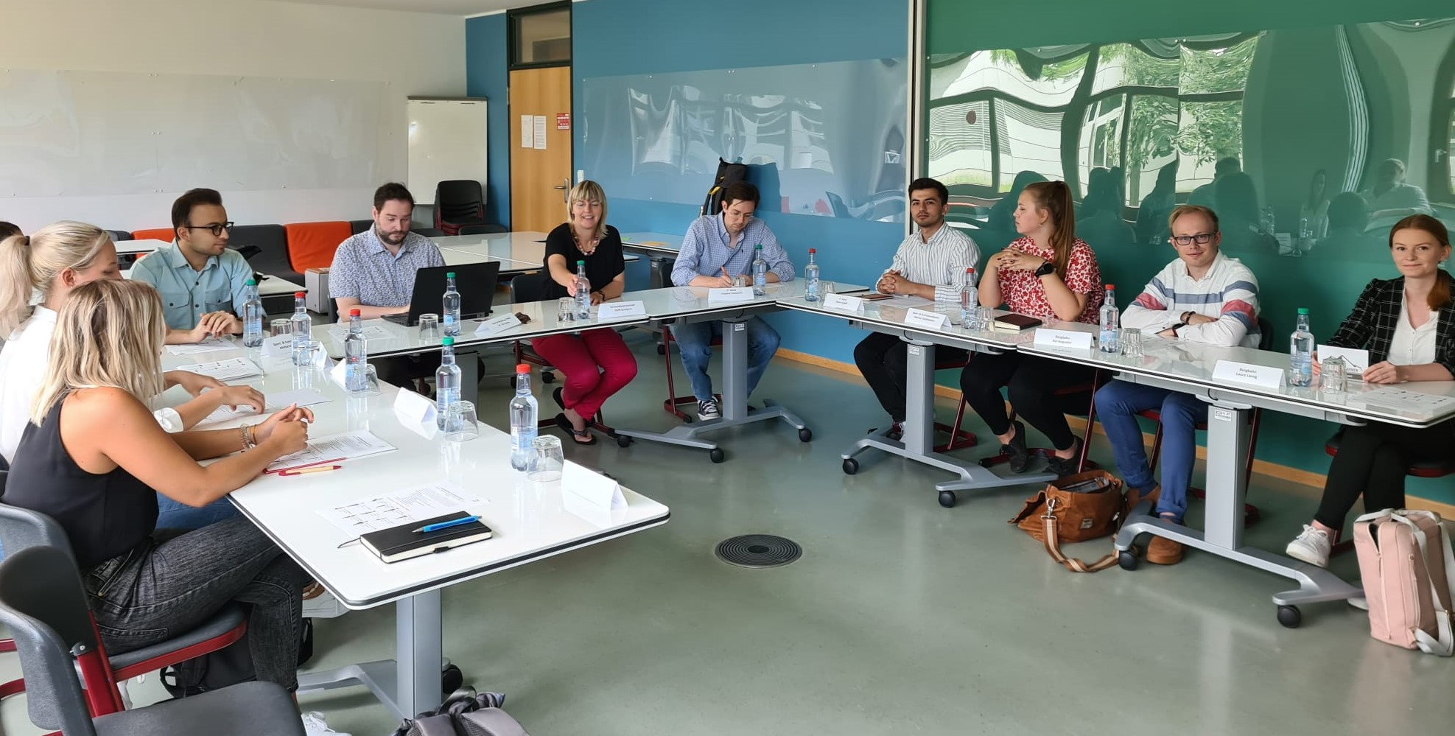
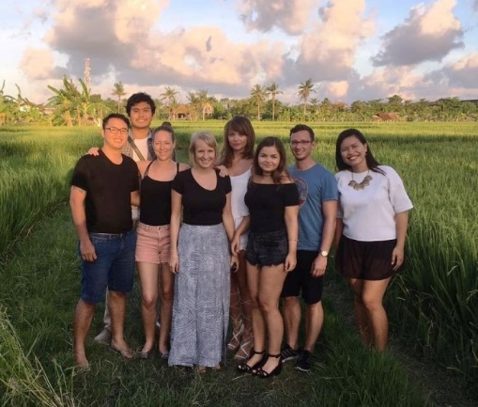
Highlights
Networking & practice partners & conferences
Coaching
Interdisciplinary guest lectures
Excursion & semester abroad & double master degree

Slide 12
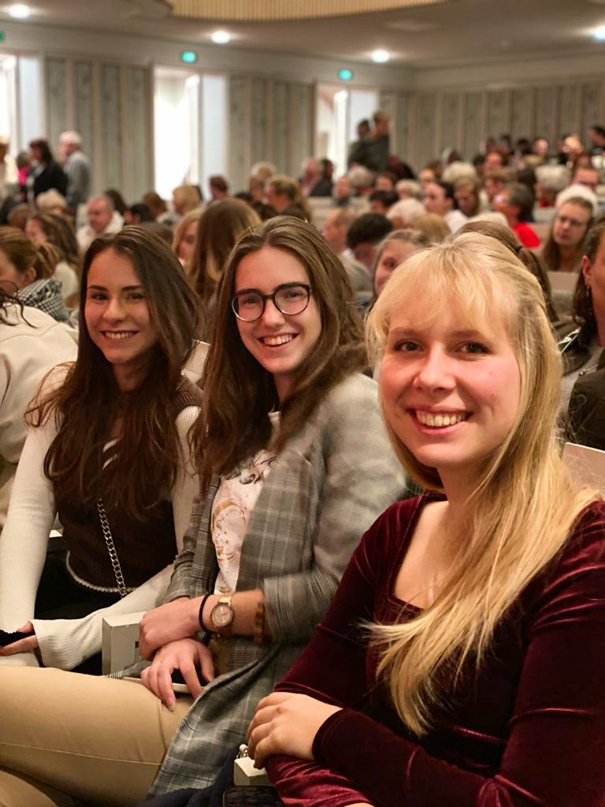
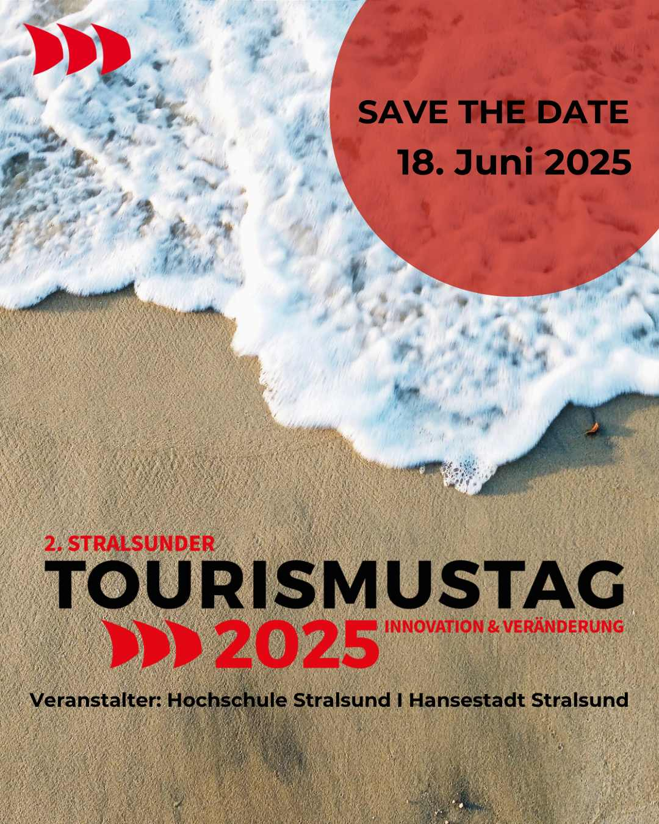
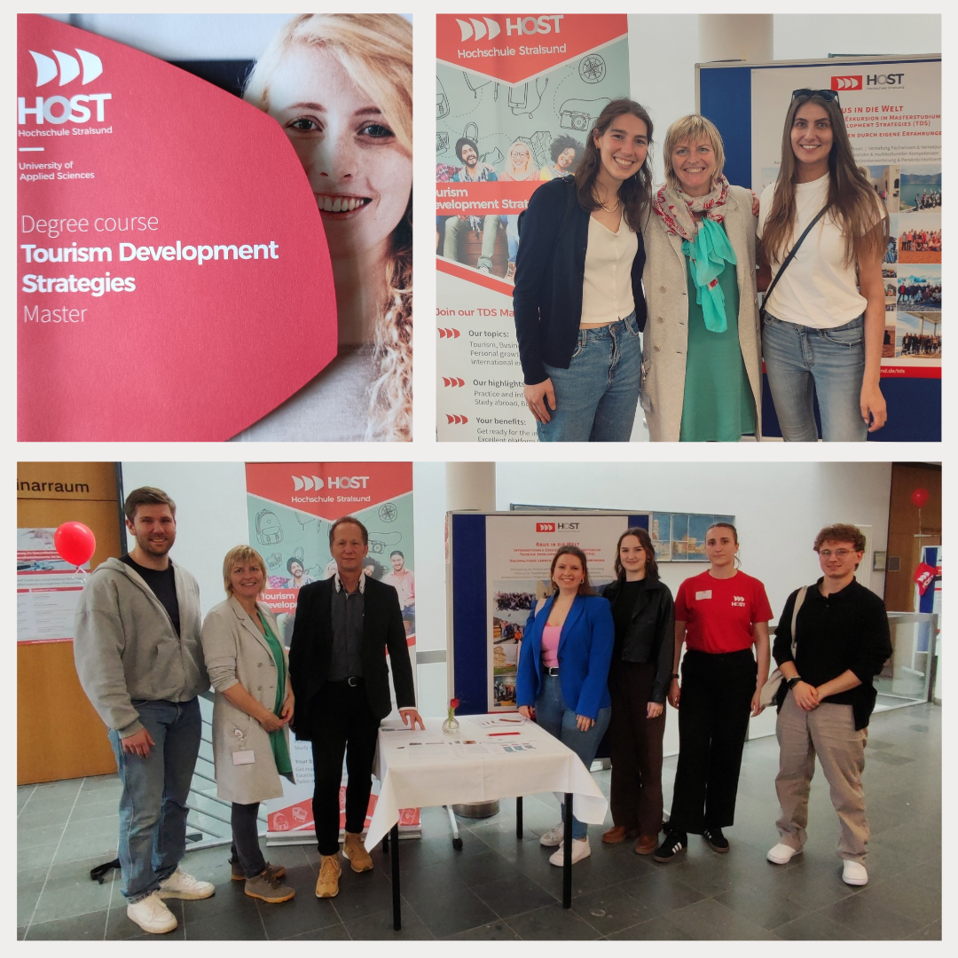
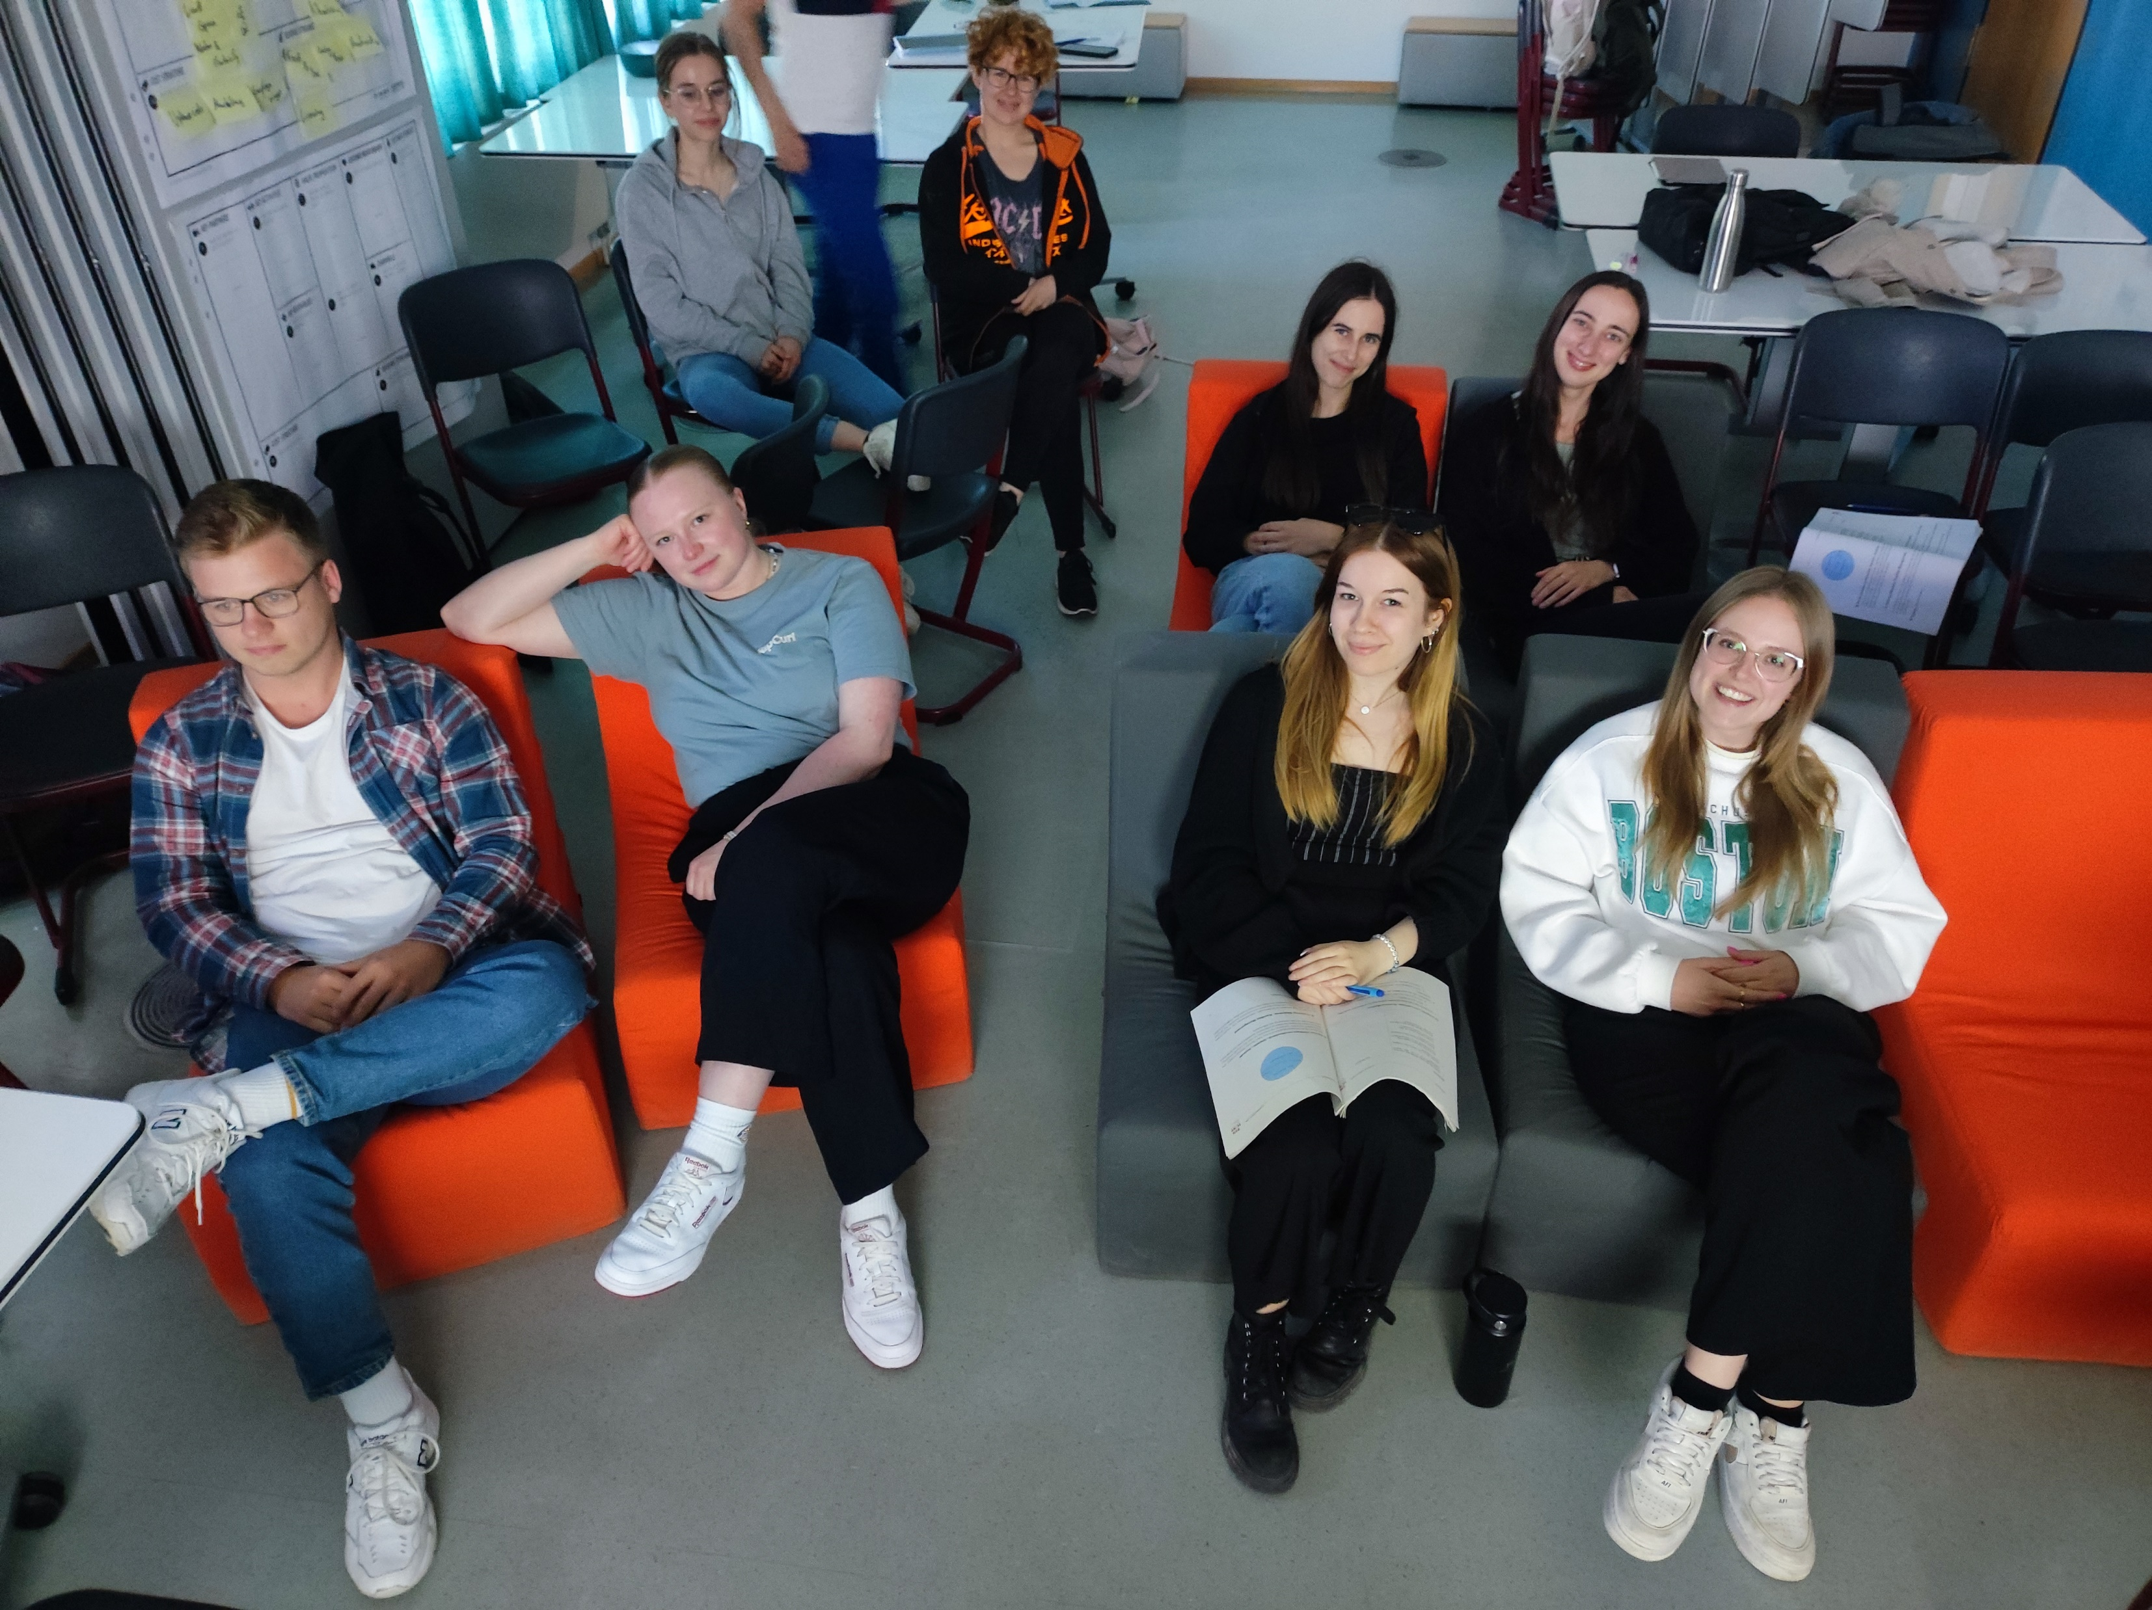
Highlights during semester

Slide 13
Highlight Excursions
International Study Trips covered by program costs (if health circumstances allow excursions)

Slide 14
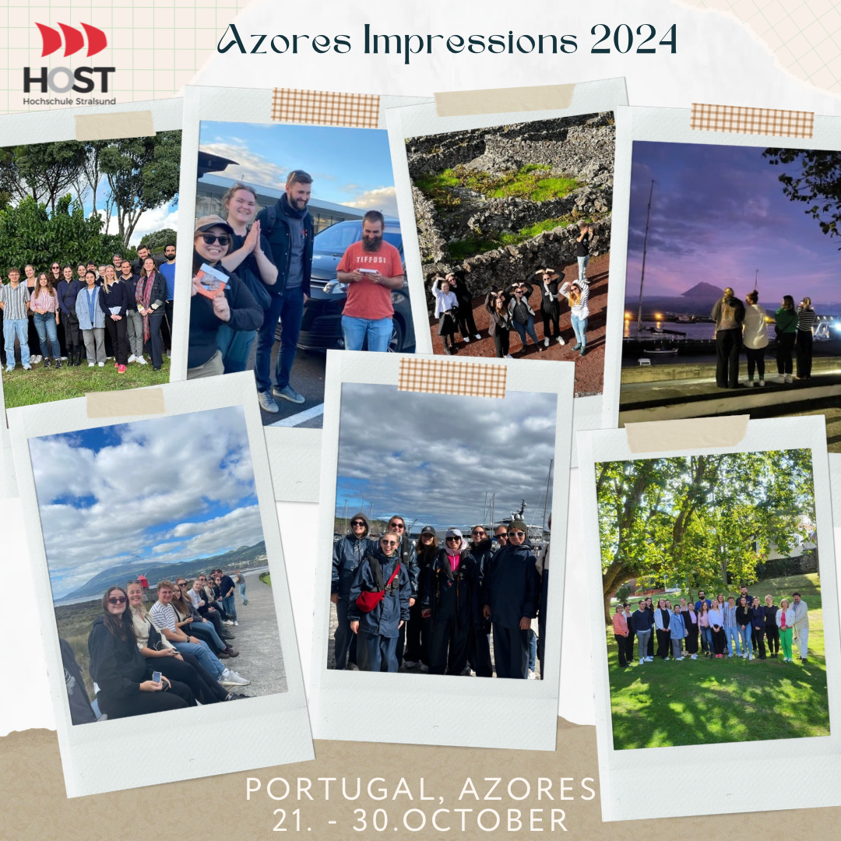
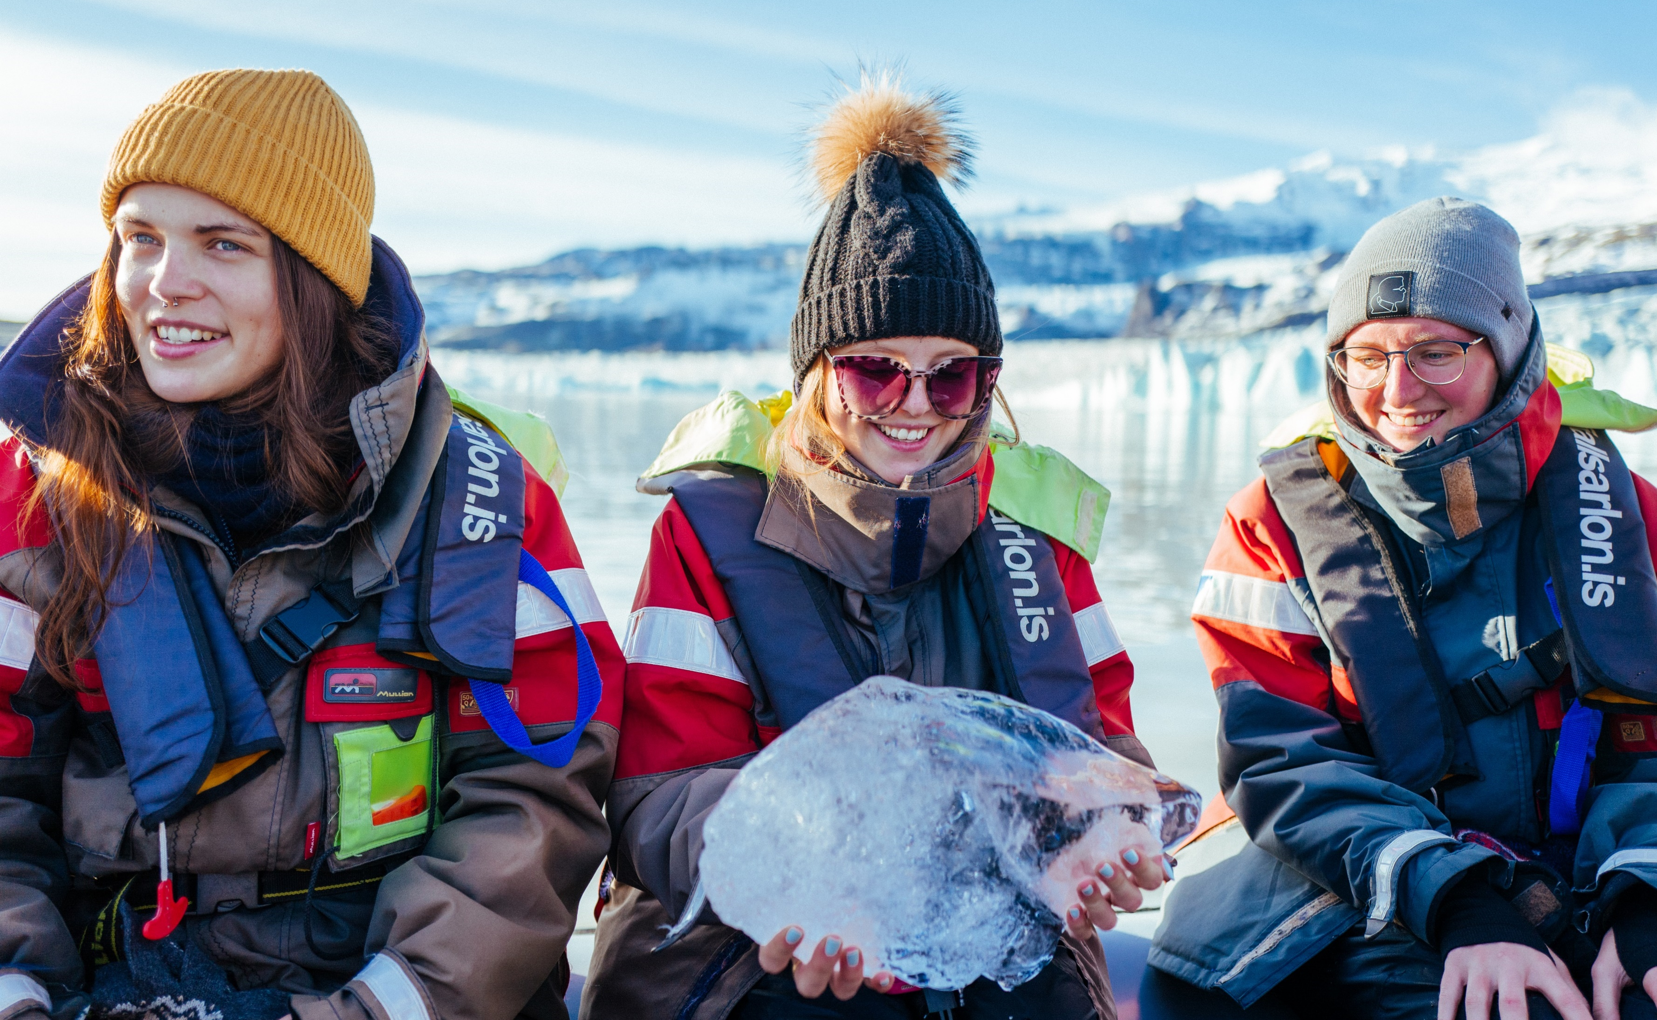
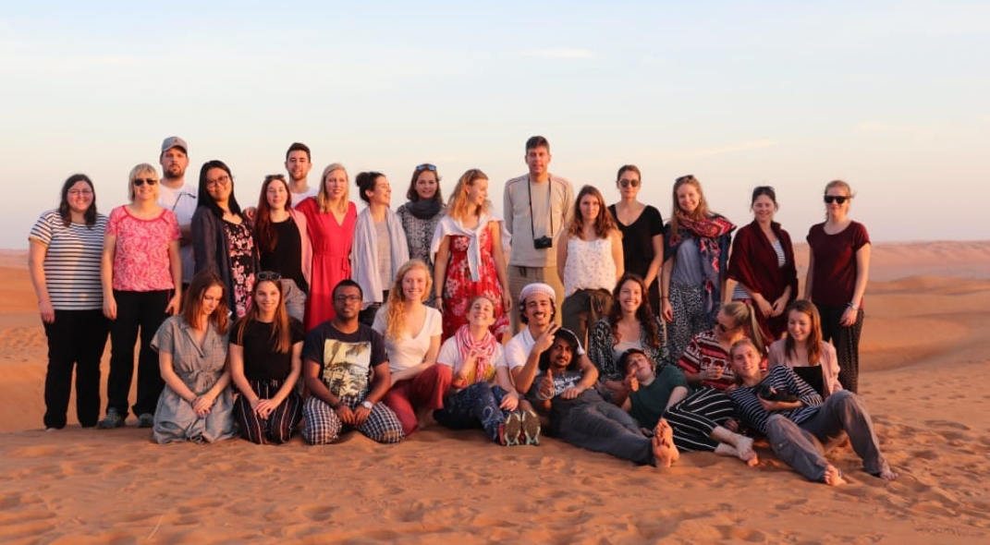
Highlight Excursions

Slide 15
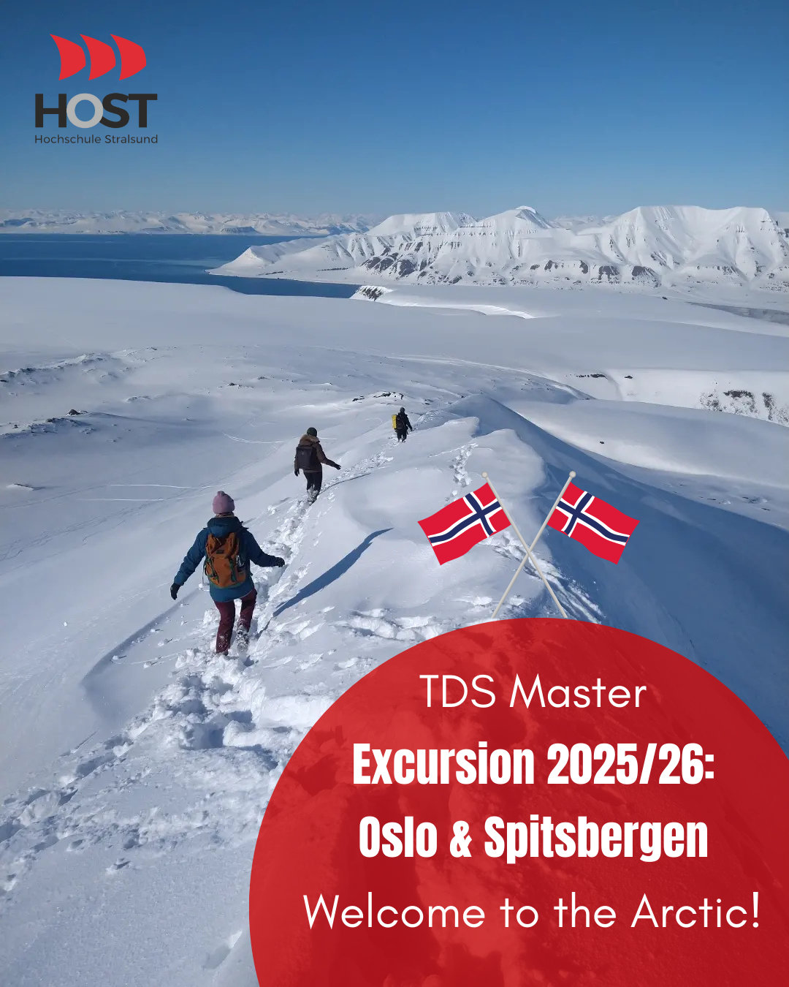
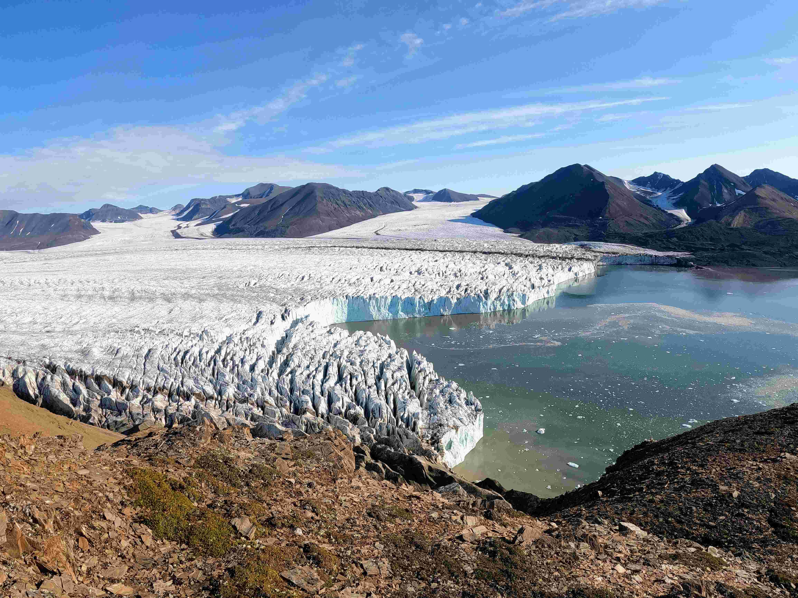
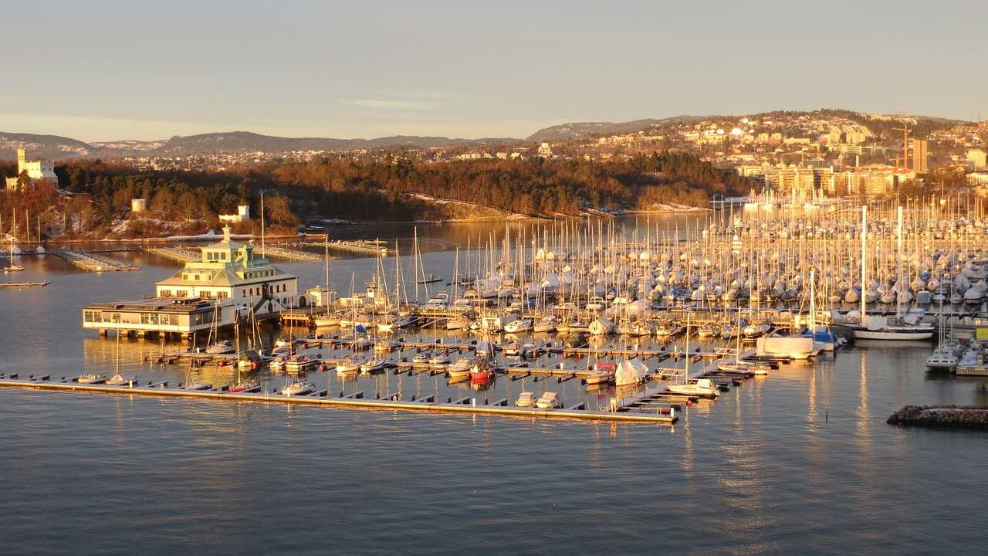
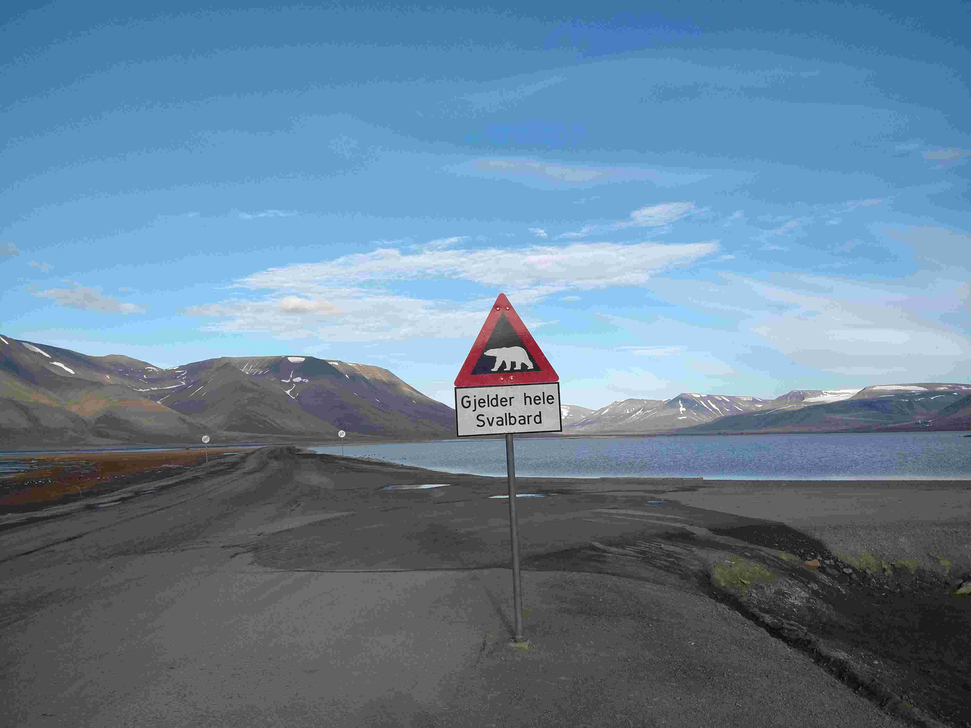
TDS on tour: next field trip, October 2025 ☺

Slide 16
Career opportunities

Slide 17
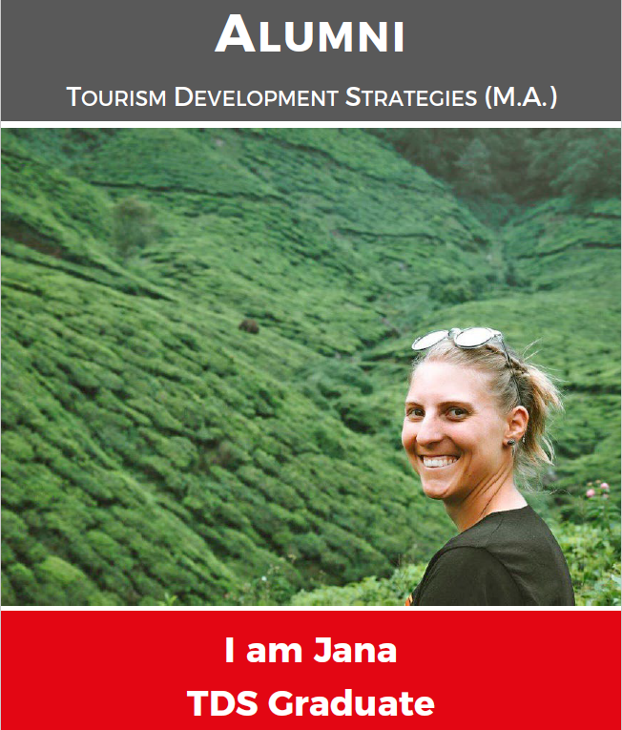
Where do our graduates work?
Destination Management (DMO, Tourism associations and institutions)
Tourism Product Development/ Management, Marketing and Sales, Key Account and Yield Management
Management & Business Development
Tourism/Consulting
Science and Research
Communication and Event sector
AIDA Cruises, BMW Group, DREAMLINES, SunExpress, Windrose, Sylt Marketing, ProjectM, GCB, Usedom Tourismus, GOPA Consultants, Tagesspiegel, Urlaubsguru, Europa Park, Viventura …

Slide 18
Admission requirements

Slide 19
Admission requirements
First academic degree in business studies 2-semester = 240 ECTS // 3-semester = 210 ECTS // 4-semester = 180 ECTS
Language skills
All semester: Proof of English skills (B2)
3- & 4-semester: Additionally proof of German skills (B2)
Signed declaration of commitment to pay the program costs
2-semester = € 1,970 in total
3- & 4-semester = € 2,170 in total
(e.g. excursions abroad, appointments at companies, social & intercultural events, conferences)
2- and 3-semester: Proof of job experience (internship) min. 12 weeks

Slide 20
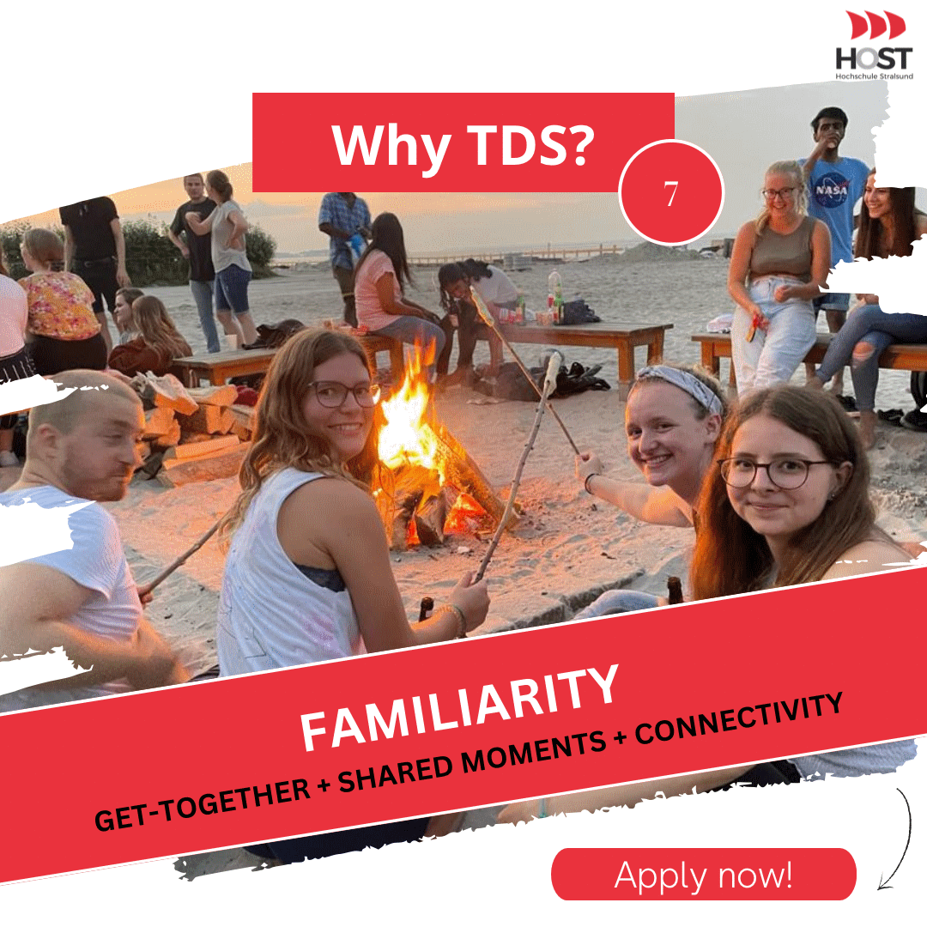
Application 2//3//4-semester
German applicants: online application https://www.hochschule-stralsund.de/studium-und-lehre/bewerbung/online-bewerbung
Upload Documents https://www.hochschule-stralsund.de/studium-und-lehre/bewerbung/online-bewerbung/voraussetzungen-und-fristen/master/
Application deadline: 31st August Please apply earlier!
No diploma at the application date?
Submit a current transcript of records,
a certificate of ECTS points achieved,
preliminary final grade and expected completion date.

Slide 21
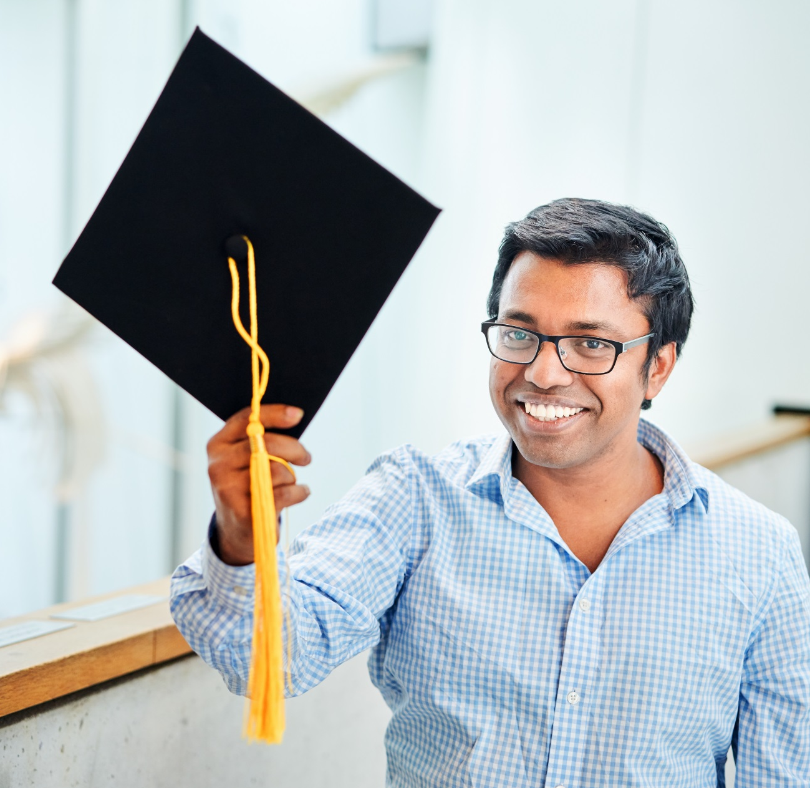
Application 2//3//4-semester
Foreign applicants + applicants who gained BA degree abroad: Online-application via UNI-ASSIST https://www.hochschule-stralsund.de/en/studying-and-teaching/international/incoming-students-staff/study-at-host/
Application deadline for none EU applicants: 30th June
Please apply earlier!
Application deadline for EU applicants: 31th August
Please apply earlier!

Slide 22
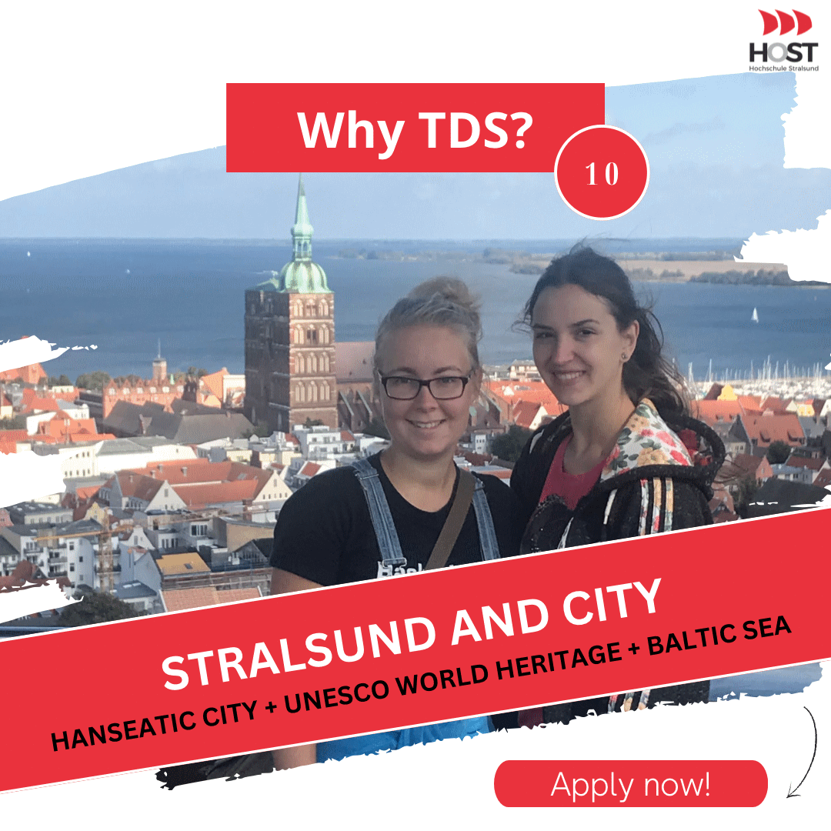
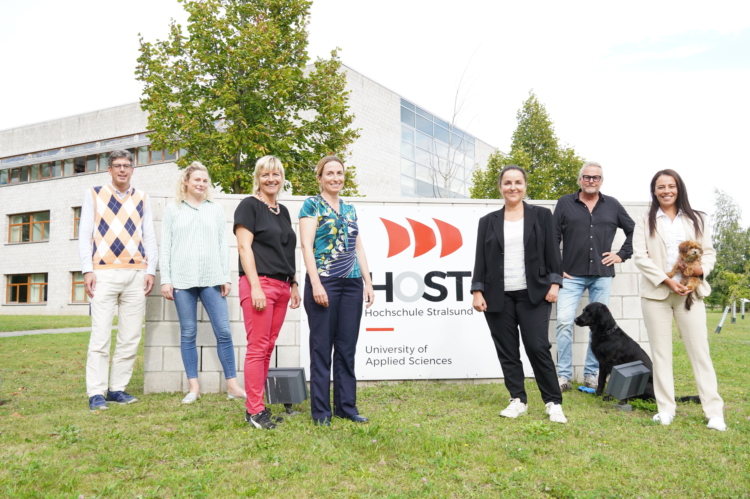
Place to live & study: Stralsund
22

Slide 23
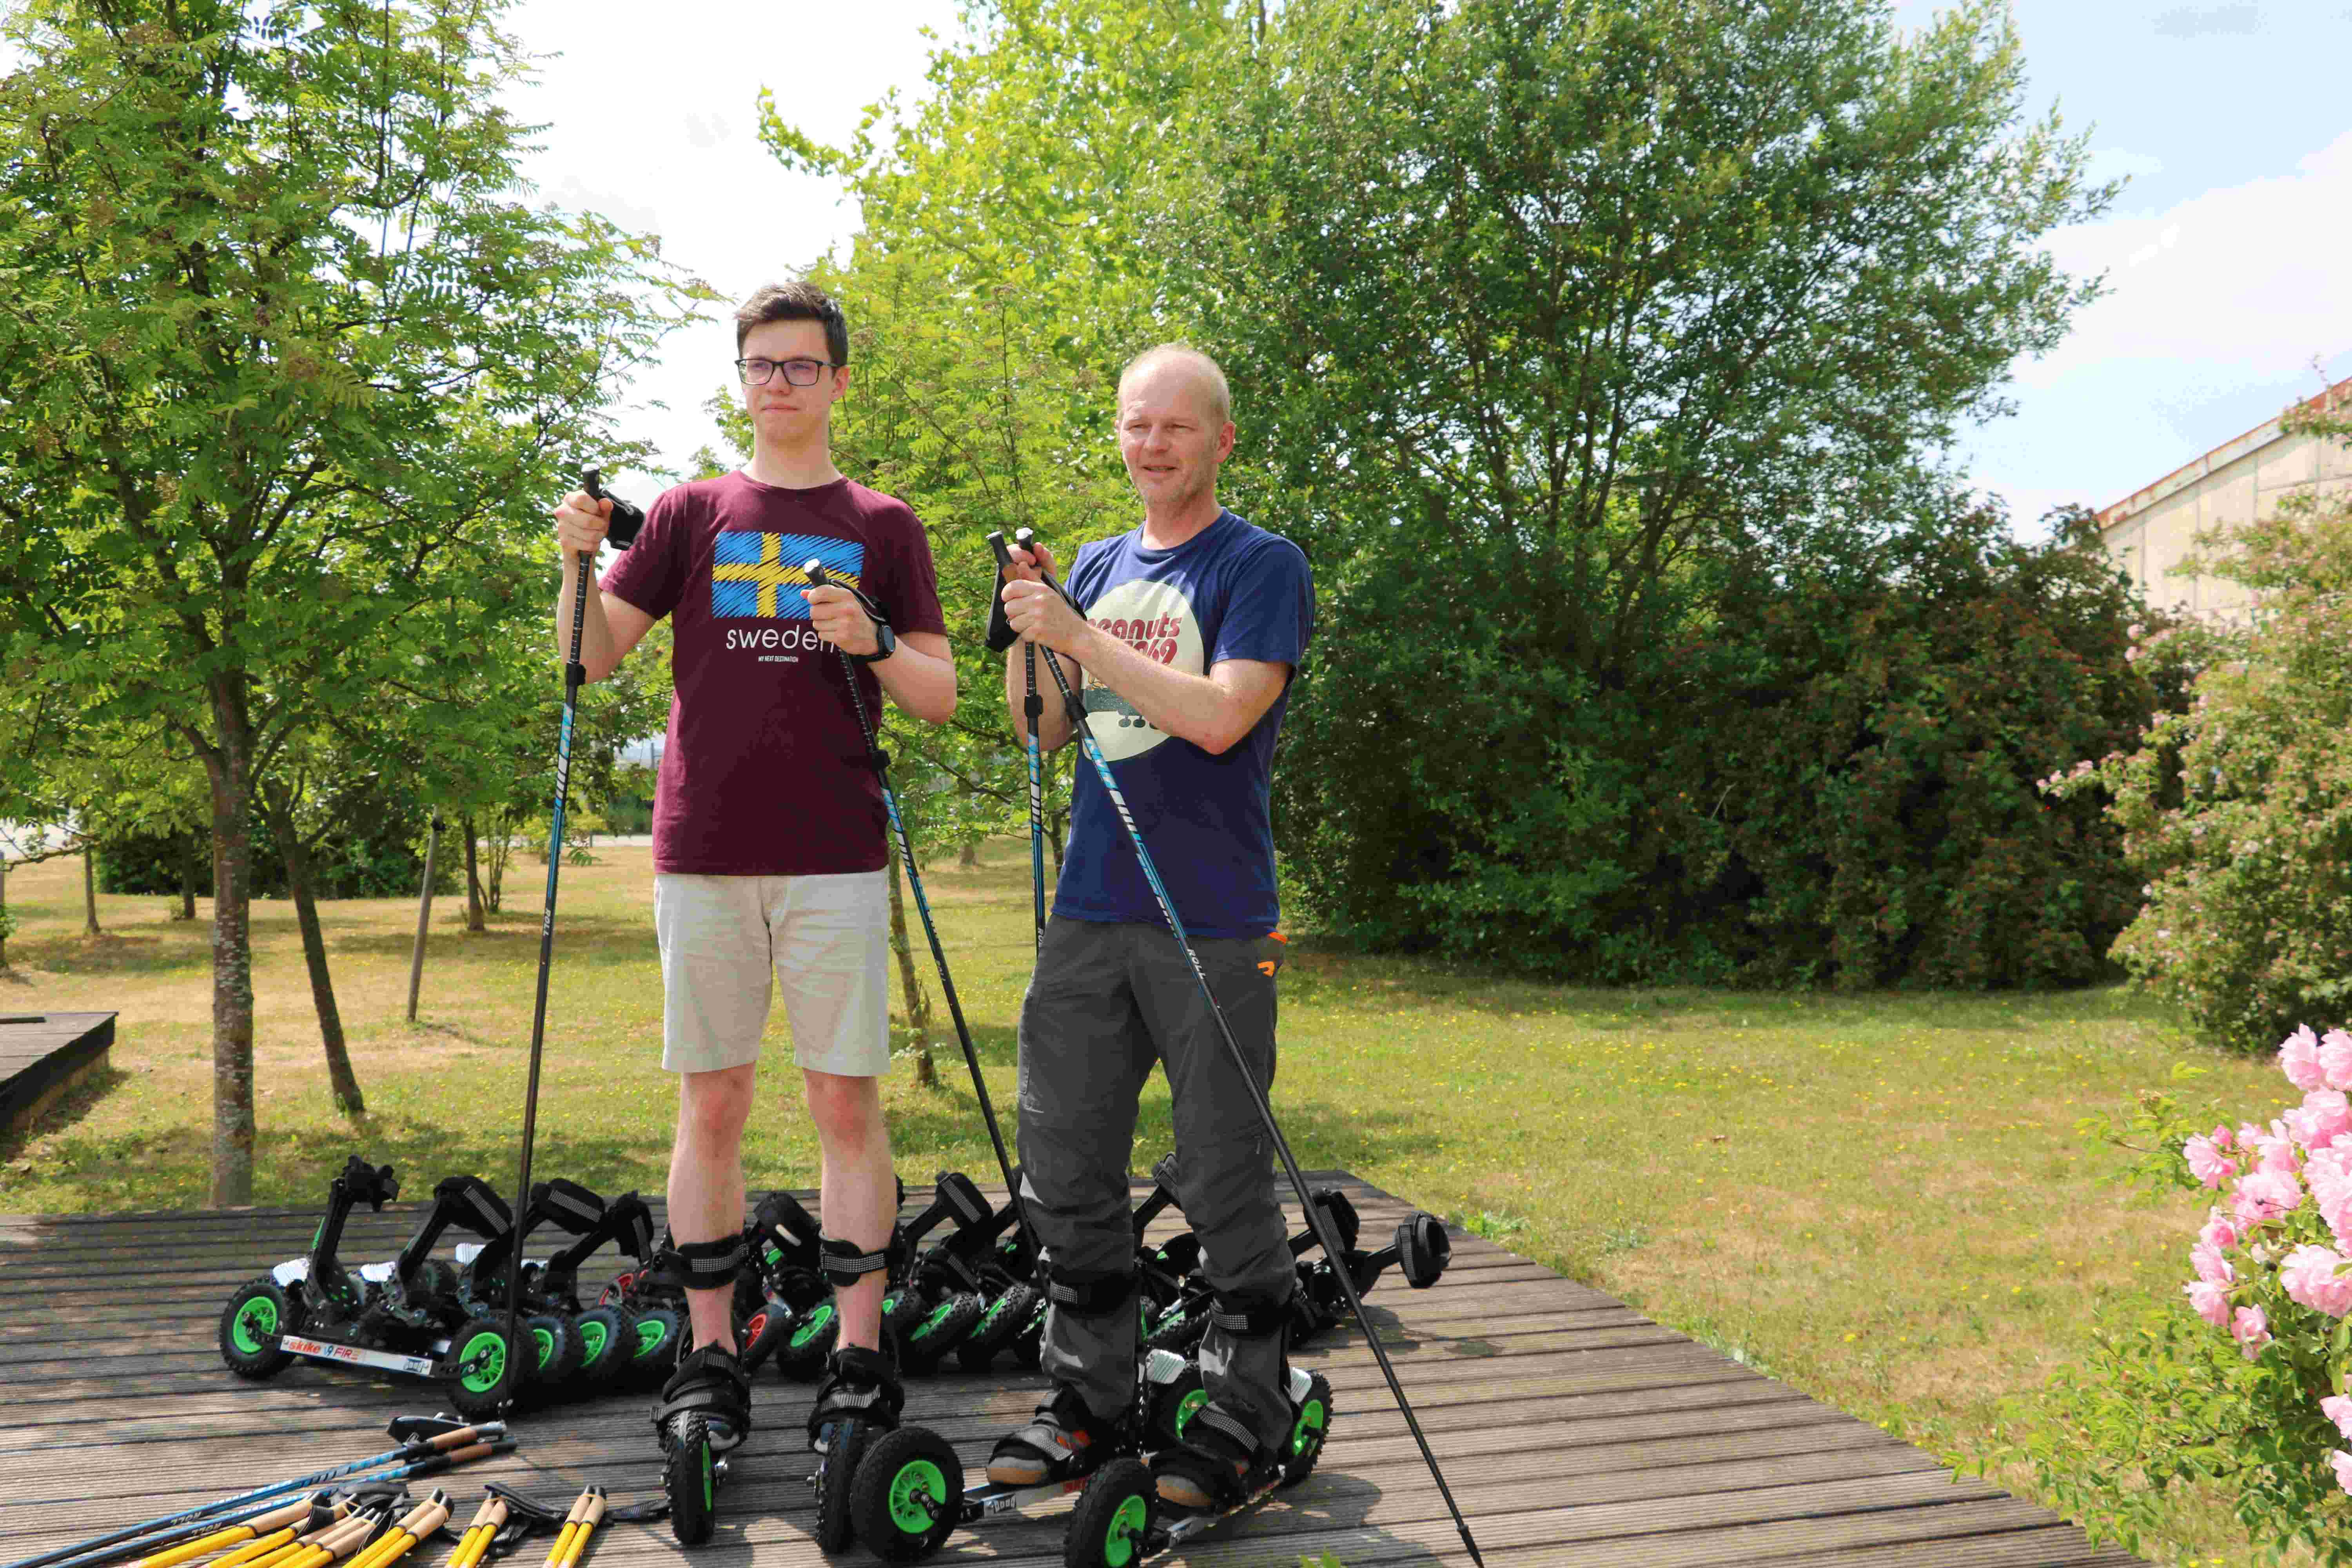
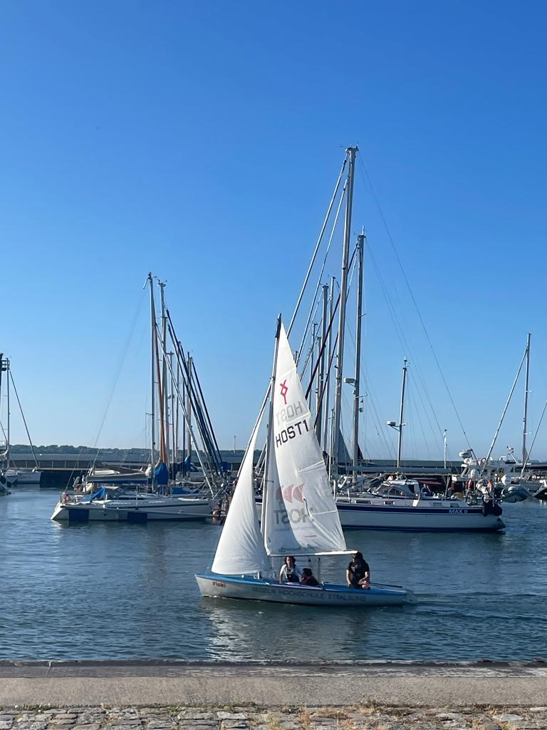
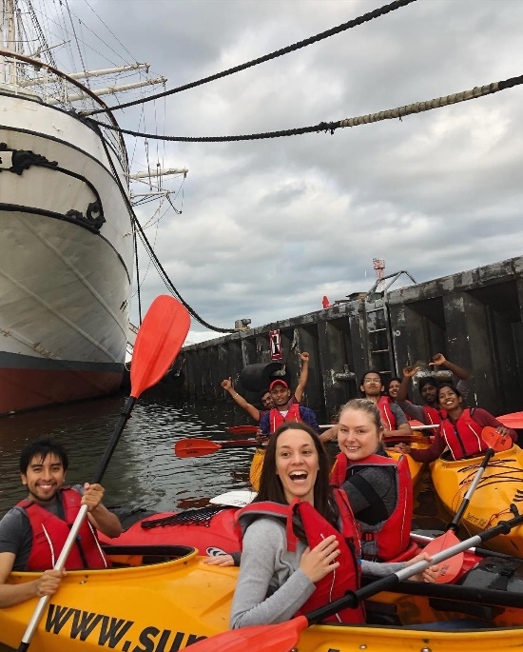
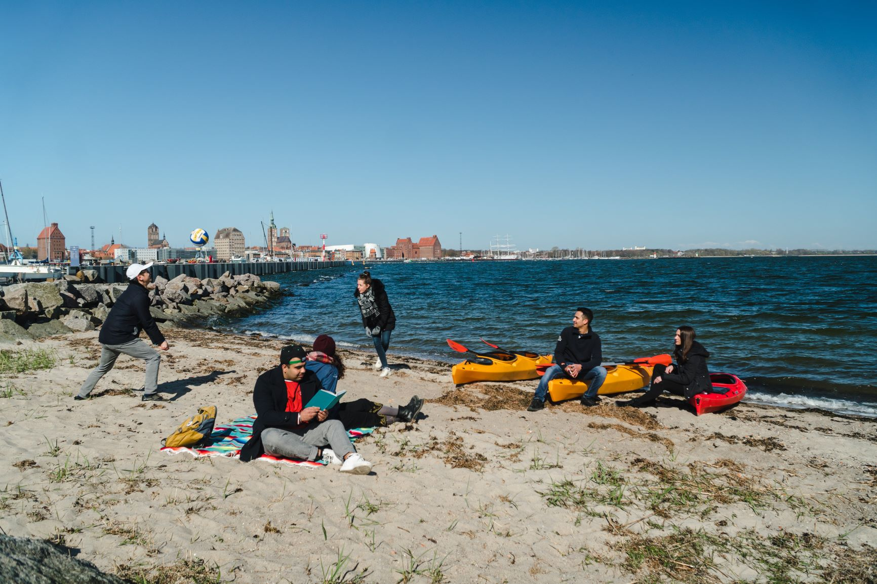
Sport activities
23

Slide 24
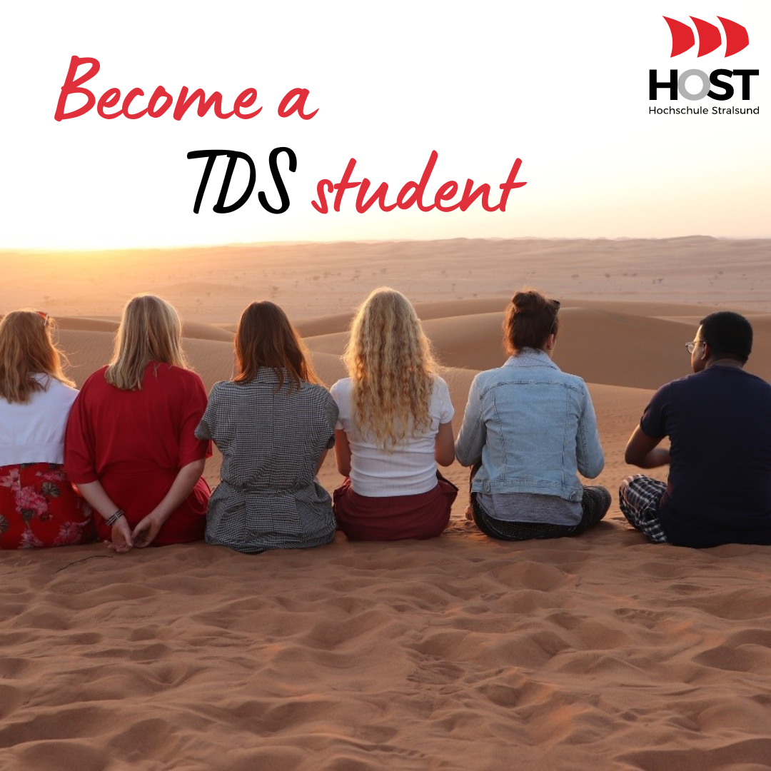
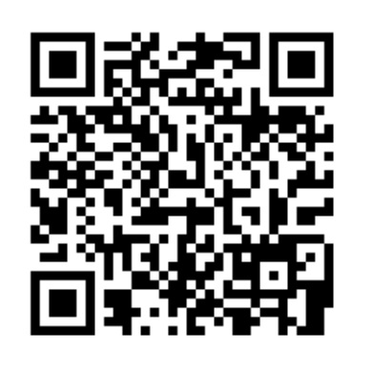
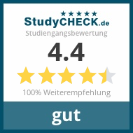
Contact:
Steffi Schnierer
Project Manager TDS
+ 49 (0)3831/ 45 70 70
tds@hochschule-stralsund.de
Follow us on Social Media ☺
www.hochschule-stralsund.de/tds
Instagram: tourismmaster_stralsund
TikTok: @hochschule_Stralsund_ws

